Slide 1

Programming Java for Longer Battery Life
Anna Rasburn
Notes:
What Diss says: - Optimisation in Java:
Optimisation in Java focuses on goals within or related to the source code can be optimised [23]. This research focuses on changing Java code and Java Projects that can be used to improve an application’s execution time and reduce an application’s requirement for the energy it needs to run.

Slide 2
Genetic Algorithms
GA are algorithms based on evolution as said by Charles Darwin.
GA use the survival of fittest and inheritance.
An “Individual” or “chromosome” is a possible solution to the problem.
A “population” is a set of individuals.
As individuals increase their fitness throughout the lifetime of the GA, the overall population has a higher fitness = a higher possibility of finding a solution to the problem.
Start
Initialize Population
Calculate Fitness of Individual
End
Selection
Crossover
Mutation
Notes:
What it says in the diss:
Genetic Algorithms (GA) are algorithms based on the biological notion of evolution and natural selection, as conceived by Charles Darwin. Genetic algorithms use the principle of survival of the fittest and inheritance. The traits of the parent who prevail are passed onto the children. Throughout the duration of the algorithm, many possible solutions to a problem are found; these solutions are called ‘individuals’. Every iteration of the algorithm selects a solution with high fitness from a collection of individuals. Subsequent iterations generate further solutions from these individuals. Some of these solutions are closer at achieving the most optimised solution to the problem and some solutions are not. The selection stage decides what traits are to be kept for the future generations. Traits that do not confer improved fitness are disregarded by the selection in the next iteration.
An “Individual” or “chromosome” is a possible solution to the problem. In a classic GA, a chromosome is a string of bits and each individual bit is a gene. The selection stage ‘selects’ individuals with high fitness that will progress to the next population. In the mutation stage, individual genes of the highly fit parent chromosome are flipped from one to zero or vice versa to create a new mutated chromosome to pass onto further populations. The crossover stage requires taking genes from the two parents and combining them to make a new individual who may be a more optimised solution to the problem than their parents.
A “population” is a set of individuals. The initialise population stage involves gathering a collection of individuals together to form a population. As individuals increase their fitness throughout the lifetime of the GA, the overall population has a higher fitness. It therefore has a higher possibility of finding a solution to the problem.
In the problems that form the focus of this project, genetic improvement problems, the individuals can be lists of changes in source code or new versions of the source code. In the GI tool Gin [2] [5], an individual is a list of "Edits". Each "Edit" is a single change to the source code such as moving a line from one place to another. The mutation stage adds or removes edits to source code and in the crossover stage, a combination of edits is combined together into a new version of the source code. An edit is similar to a gene but not a direct parallel because an edit is what has changed in the code. A "patch" is similar to a chromosome but not by the traditional definition because a "patch" may comprise of no edits if it happens that in the current version of source code in also the most optimised source code. A patch could also contain a collection of edits to create the optimised source code. In the Gin Code [5] [2], a collection of patches is like a classic genetic algorithm’s definition of a population.

Slide 3

Fitness
Fitness of an individual is how well that particular individual performs the task.
In AnnaGin the finesses are:
Does the new source code compile?
Does the new source code pass the unit tests?
What is the energy consumption of the application?
Lexicographical fitness - when one elements of fitness is prioritized over another notation of fitness so in AnnaGin is that if unit tests are not passed, the energy is not measured.
 | Did the source code compile? | Unit tests |  |  | Energy Consumption | Use this individual?
 |  | Unit test 1 | Unit test 2 | Unit test 3
Individual 1 | Yes | P | P | P | 3000J | Yes
Individual 2 | No | P | P | F | N/A | No
Individual 3 | Yes | P | F | F | 2100J | Yes
Individual 4 | Yes | F | P | P | 4000J | Yes
Notes:
Whats in the diss?
As mentioned previously, the fitness of an individual is how well that particular individual performs the task. In this instance, there are several potential measures of fitness, for example, one can ask: Does the new source code compile? Does the new source code pass the unit tests? What is the energy consumption of the application? This has meant that each element of fitness needs a weight, which is how important that element is in the fitness function. For example, whether the source code can compile has a larger weight than the unit tests because if a program does not compile then the unit tests are irrelevant as the program has lost all functionality. Table 1 presents the different elements of the fitness and a way that the different weights can be used together . In the example below, Individual 3 would be the most optimised because it has passed the most weighted elements, such as that it can compile and energy consumption although it failed two-unit tests .
For any optimisation problem, the fitness function needs to be defined before a solution is executed. Changing the fitness function can present new ways to optimise Java. For example, by changing the fitness to focus on execution time or energy consumption, the Java application can be optimised in different ways.

Slide 4

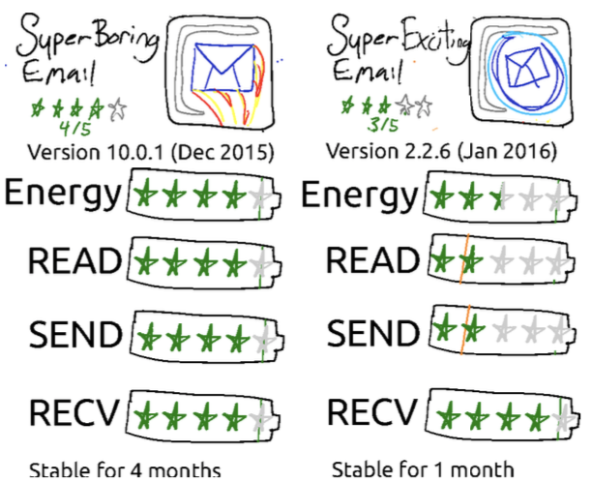

Green Software Engineering
Hindle - a type of software engineering which is more environmentally sustainable, so it takes into consideration the power usage of creating software.
Basically as software engineers we need to be smarter in how we program and create stuff that uses less energy so we can save earth!
AnnaGin combines Green software engineering and GI
Notes:
What the diss says:
Green Software engineering, a term coined by Hindle [4] is a type of software engineering which is more environmentally sustainable, so it takes into consideration the power usage of creating software. There are very few uses of physical measurements in software engineering even though this is critical for measuring energy. This lack of physical measurement creates limitations regarding experimentation and analysing energy usage .
Green Software Engineering is an important, yet emerging field. Because this field is at an early stage of development, it has been marked by a low level of resources, a small coherent community and an uncertain methodology. This field needs an increase in support and research, which can pose a negative image of making the field an ‘impossible bar' [4] that may not be achieved. An increase in support and research may come with the recent developments about climate change [21]. This issue has only amplified the importance and necessity of this research of the desire to keep our current technology-heavy lifestyles, as well as to ‘limit climate change’.
Research that was conducted by Hindle focuses on software’s interaction in other contexts other than mobile applications. Hindle researches in mobile applications, Data Centres and embedded sensors. Hindle has a proposal to have an energy rating on mobile applications included with the mobile application other functions; an example of this can be seen in Figure 2.5. Therefore, the user has the responsibility of choosing a more sustainable application, which offers an interesting proposal as it gives the user more responsibility and can be used as an extra selling point for a mobile application.

Slide 5
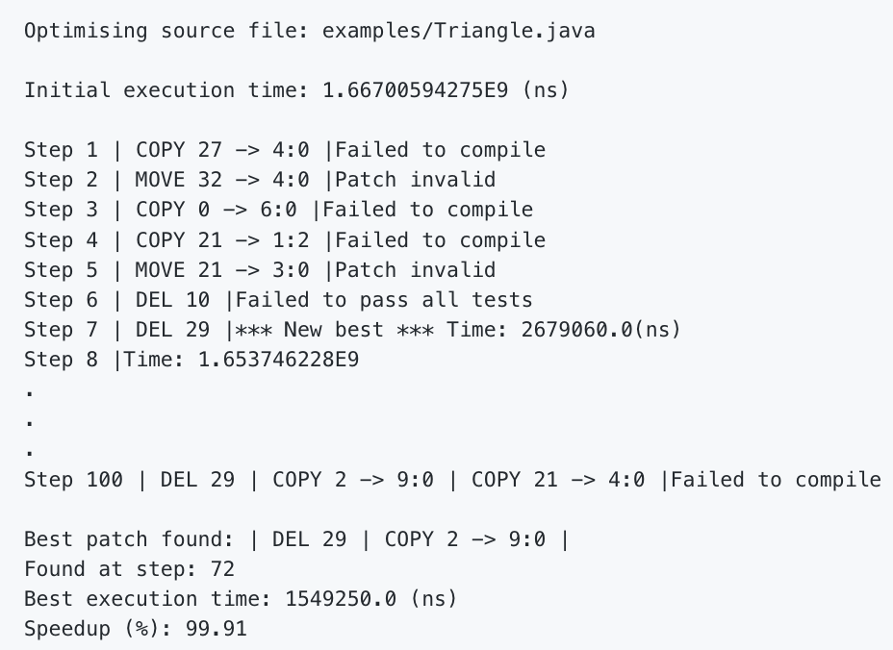
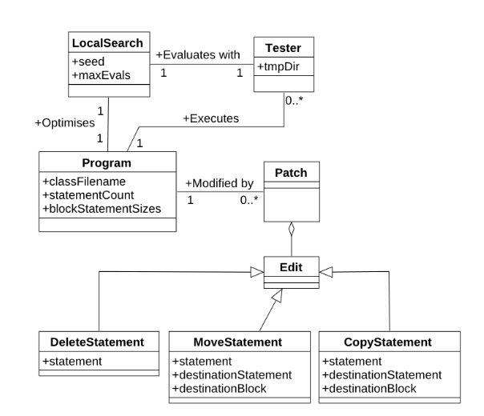
Gin
Java tool that makes it easier to implement Genetic Improvement and has a goal “to stimulate development in GI tooling”
GIN manipulates code in three principal ways: deletion, copying and replacement.
It creates a version of the code that passes all the unit tests and has a lower execution time.
Notes:
What the Diss said:
GIN, Genetic Improvement in no time, [12] is a Java tool that makes it easier to implement Genetic Improvement and has a goal “to stimulate development in GI tooling” [2] [5]. The Gin application itself optimises a Java class, using a local search to add “Edits” to the source code until a more-optimised version of the code is found. As seen in Figure 2.2 and 2.3, GIN manipulates code in three principal ways: deletion, copying and replacement.

Slide 6
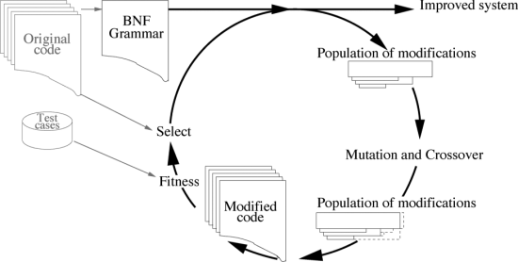
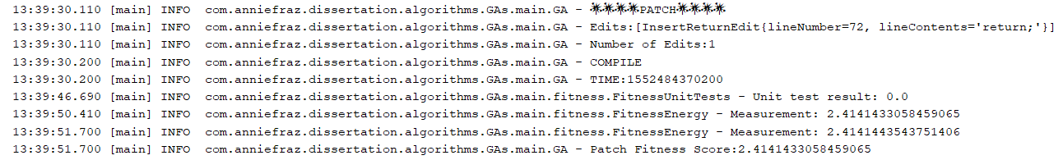
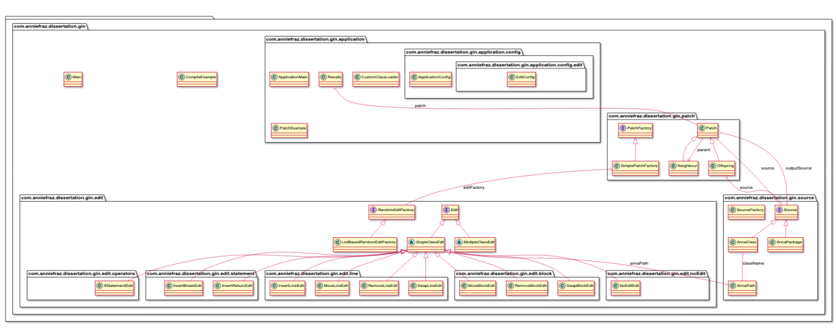
AnnaGin
This toolkit takes some source code and applied a random selection of ten different edits to make a patch.
A Genetic Algorithm is then applied find the best combination of these edits.
A good combination of edits is one that uses less energy than the original source code.
Notes:
What the diss says:
To begin with, I created a toolkit in a similar style to the Gin toolkit [5] [2]. The toolkit I implemented had a different structure and used different edits in comparison to the Gin toolkit. This was done because I wanted to learn how Gin worked and what techniques they used that I could use or manipulate for my own toolkit. Creating my own toolkit allowed for me to explore different areas that we can optimise code and gave me freedom to try new ideas. I also personally found it easier to create my own toolkit, rather than try to add changes to the Gin tool, which is constantly being changed and refactored by multiple universities and professors with their plethora of ideas .
The purpose of the toolkit was change Java programs in a variety of ways. For example, the toolkit starts with the code seen to the left in figure 4.1 and the aim of the toolkit is to change this code into the code on the right of figure 4.1. Figure 4.1 is labelled with the different edits applied to the code.

Slide 7
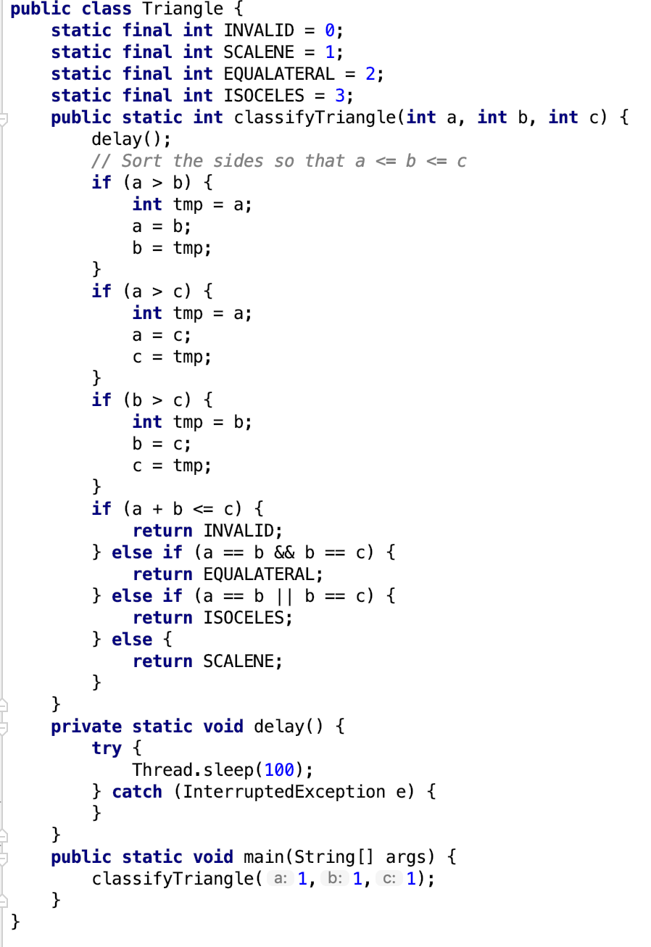
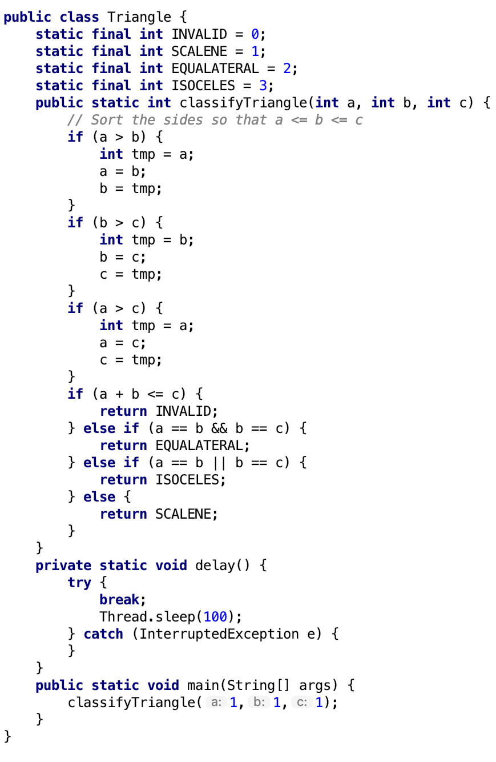
How AnnaGin works:
1.
2.
3.
4.
Insert Break;
Remove Line Edit
No Edit
Insert Return;
Move Block
Insert Line
Move Block Edit
Test-runner
&Opacitor
Types of Edits
Move Line
Swap Line
Remove Block
Swap Block
Remove Line
Insert Break Edit
Notes:
What the diss says:
Similarly, to Gin, during the early development of the toolkit, I used the ‘Triangle program’ for testing to see whether I can optimise a program. The triangle program is a simple program that only consists of one file, has a main method and is written in Java with corresponding Junit tests which fits in the current capacity of the toolkit. The Triangle program has 43 lines and with our 10 edits, this creates a ten billion sized search space.

Slide 8


So How is it working out energy ? OPACITOR
The Opacitor is a tool by Dr Sandy Brownlee et al that measures energy of source code in three ways:
Code length
Bytecode - measures the energy consumed by running a program in an external JVM
Jalen – This uses execution time to guestimate energy
I used the Opacitor to work out the fitness of each patch (as well as unit tests)
Notes:
What the diss says:
Opacitor [16] [1] [17] [6] is a tool which measures the energy consumption of JVM programs. It does this by using a bytecode level model of energy cost; counting the bytecodes executed by a running program and matching these to previously measured quantities of energy consumption. Opacitor ‘can detect small changes in execution profile, down to opcode level’ [6] therefore it records the energy used by a program down to its lowest level. The Opacitor measures energy usage in joules and, unlike many similar tools, does not use a CPU as a proxy for energy use. Therefore, using joules and bytecode increases the accuracy of the readings.
Opacitor is one of the first tools of its kind to measure the energy produced by an executing program using Search-Based Software Engineering. Due to the implementation of the Opacitor it can detect the smallest changes in execution, thereby recording all the possible energy usage from the entire execution of the program. The Opacitor is unaffected by the rest of the computational environment so that when it examines the smallest changes these are the only changes in the program and does not include any other environmental factors.
The Opacitor is deterministic, i.e. it will produce the same output from a given input. The Opacitor’s results have helped reduce a program’s energy usage by up to 70% in the best case and 20% in the worst case [1]. The Opacitor is one of the few tools that can detect small changes in the execution and is responsive to metaheuristic searches [1].
The Opacitor's only focus is on the CPU and it does not consider other features of a mobile phone that use a large amount of battery power such as the display, WI-FI and GPS. The Opacitor is exclusive to applications and the CPU does not consider other features or how they work with applications and the effect that they may have on the battery.
Opacitor provides services that can disable the Java Garbage Collector and the Just-In-Time Compilation. Java’s garbage collection adds a stochastic behaviour to the energy consumption of code. In practice, this will average out over multiple runs, so for preliminary experimentation it is desirable to simply disable GC to make the measurements deterministic. Likewise, Java’s just-in-time compilation massively reduces the run time of code – making the energy consumption harder to measure precisely. In practice, the relative measurements for two pieces of software are comparable [1] increasing the desirability by disabling JIT for experimentation. Opacitor provides the option to disable both GC and JIT.

Slide 9
Which edits worked the best?
In the triangle program seen earlier there were a few edits that worked really well:
Remove Edit line saved 0.100J
Insert return edit saved
0.096J
Move line edit saved
0.100J
Insert Break edit saved
0.096J

Slide 10
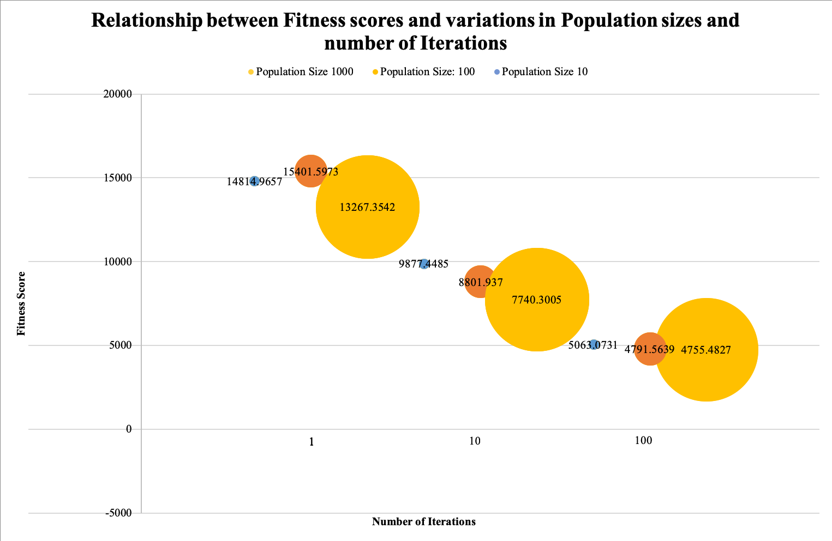
How Did the GA do?
As you increase the size of the initial population and number of iterations, the average fitness of the population decreases.
This means that the GA gradually improves as time goes on and gets better at finding a solution.
Notes:
What the diss said:
Throughout the project, two important questions were asked: What changes to code can developers make to reduce the program’s energy consumption? And can GI techniques like a GA find a version of the code that uses the least amount of energy?

Slide 11


Further Work to be Done
Using AnnaGin on bigger files -> Data centers?
This toolkit can be made for more languages rather than just Java
Fitness's can be changed to look at other problems e.g. Memory, Bug fixes
There are probably endless edits that can be made.
Use other AI techniques than just GA such as Hill climber

Slide 12

Thank You for Listening! Any Questions?

